Slide 1
Table of Contents
Overview of Standard measurements and data scaling
Sensor Deployments: by Station & by Sensor
Standard Data & Scale Factors (by sensor):
  Guide to viewing data/slides
  FLCD#1973
  FLCD#1686
  WSCD#1337
  WSCD#1338
  WSCD#1339
Results of Scaling Data (by station)
  SATURN-03
  SATURN-04
  SATURN-01
  SATURN-02
  SATURN-07
  SATURN-09
Results: Data Comparison
  Movie comparing CDOM vs. Salinity at SATURN stations over time

Slide 2
Overview
Measurements in reference solutions have been made with SATURN CDOM sensors going back to mid-2012
  De-bubbled Sodas : Diet Sierra Mist (DSM) & Sprite Zero (SZ)
    Earp et. al (2011) showed sprite zero to be linear within the concentration range typically measured at SATURN stations, with ~4% variation
    We measured ~5% variation in laboratory evaluations of the soda solutions (data not shown)
    Both solutions used before March of 2016 , after which only SZ was used
  Quinine Sulfate Dihydrate (QSD)- measurements since April 2015
    Measurements in this solution began in April 2015
    This is the preferred standard solution; used by manufacturers for sensor calibration.
  These data were used to scale/relate the data between stations/deployments and provide an understanding of changes in sensor calibration over time

Slide 3
Scaling All Data to a Common Scale (slide 1 of 2)
Differences in manufacturer calibrations over time combined with individual sensor differences have led to significant variation in sensor responses in the same standard solution (both between sensors and for the same sensor over time). The reference solution measurements were used to scale sensor output to a single calibration allowing for the inter-comparison of data between different sensors/stations over time.
For each standard an ‘expected value’ was determined.
DSM & SZ: used measurements from two WETLabs sensors that were made shortly after the sensors were calibrated in January 2014
- Sprite Zero = 48 ppb
  - Diet Sierra Mist = 32 ppb
  QSD: data in this standard include more bad/outlier readings and the process for using this standard solution is still being refined. For the mean-time a temporary value was assigned where the resulting scale factors are in closest agreement with the scale factors based on sprite zero measurements.
**this approach is temporary**
If we were to assign 100ppb as the expected value for the QSD solution, all CDOM data would need to be adjusted by a factor of more than 3-fold which is unlikely the case and would be in large disagreement with manufacturer calibrations.

Slide 4
Scaling All Data to a Common Scale (slide 2 of 2)
Scale factors were calculated for all sensors checks using the ‘expected’ standard value (using SZ data)
  The Sprite Zero readings were used in most instances because readings in this standard go back to 2012, and the readings in this standard appear to be the most reliable/consistent.
  Readings in all three standards were be compared, allowing for the identification of anomalous readings in the various solutions
  This approach assumes soda consistency
  This will bring all historical readings to a common scale
  The common scale used is based on the January 2014 WETLabs calibration
  Notes:
  These adjustment do not CALIBRATE the sensors/data; they only scale sensor responses to a common scale for inter-comparison.
  The majority of adjustments to the data were ~10% or less.

Slide 5
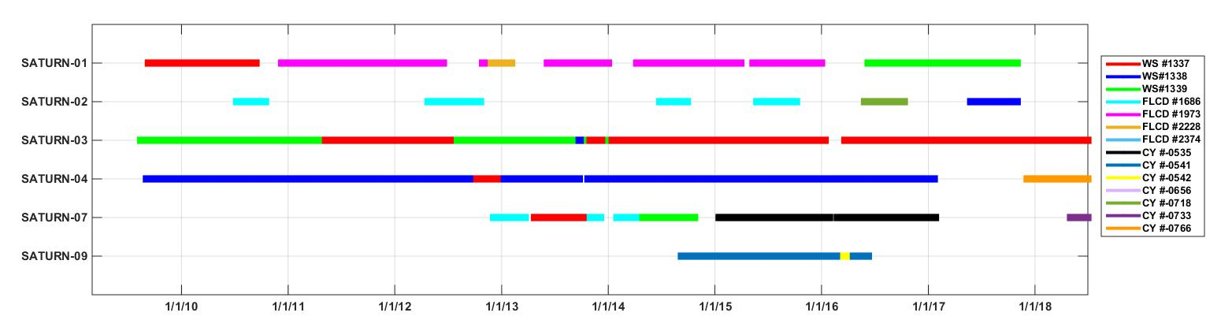
Overview of CDOM Sensor Deployments (by station)

Slide 6
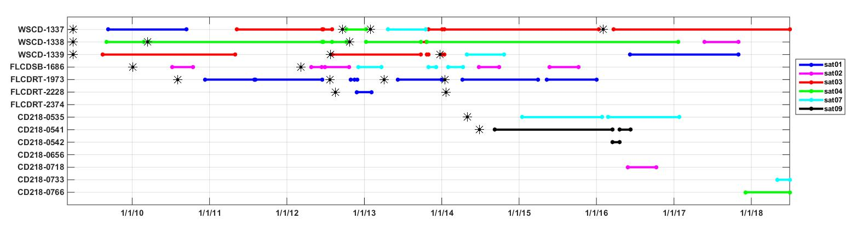
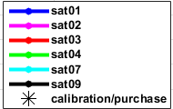
Overview of CDOM Sensor Deployments (by sensor)

Slide 7
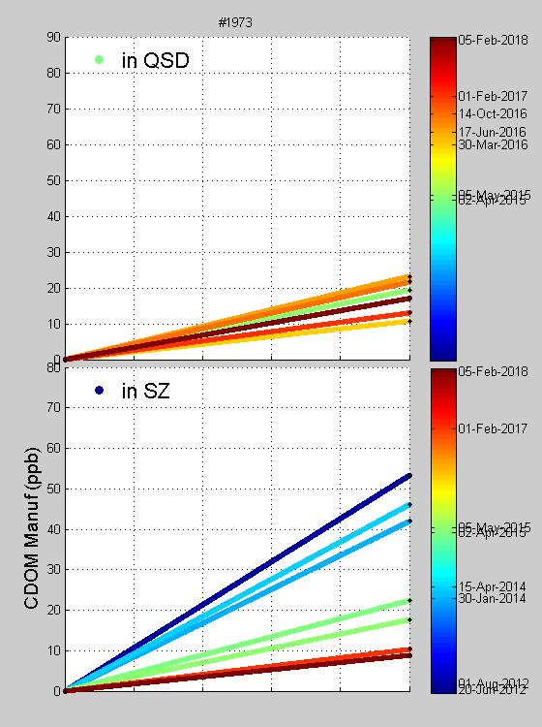
Guide: Information Provided on Sensor Data slides:
Deployment Figure:
A plot at the top shows the various deployments of that sensor
Tables:
The top table provides the sensor readings in the two standard solutions. Output has been converted to ppb using the manufacturer-supplied calibration coefficients. The scale factor and offset to the right are calculated from the SZ and DI water readings along with expected values (see slides 3 & 4).
Plots:
Plots are provided of the various measurements in the standard solutions: SZ (bottom panel); DSM (top panel).
The lines connect the reading in DI (0ppb or 0%) and the reading in the standard (100ppb or 100%) for the various times measurements were made. The slopes of the sensor response and the offset can be compared.
The lines are colored by time (with time-scales consistent across all the three plots and with slides for other sensors.
If there are note-
worthy groupings
or outliers they
may be circled
and associated
comments provided.
The bottom table shows the scale factor and offset applied to the data before and after the 2018 revisions. Time ranges were determined by the dates of sensor checks along with calibration dates or other obvious shifts in sensor output. The corrections are sometimes applied for extended periods of time where additional information or assessments of sensor performance are not available. With the 2018 revisions, an attempt was made to apply a single correction over longer periods of time if various checks during that time were within fairly close agreement and differences are possibly due to sampling/measurement variability.
Comments:
General conclusions may be supplied on the slide or in the ‘notes’ section of the slide if space is limited (not visible during slideshow)

Slide 8
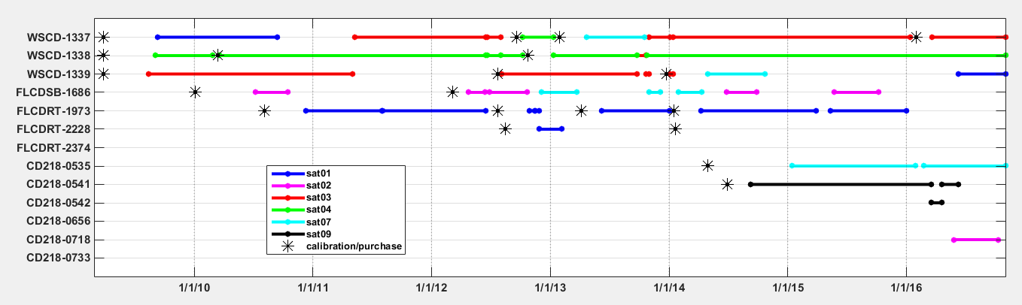
Standard Data and Scale Factors for FLCD#1973
SF = expected/(observed – DI)
offset = DI*SF
Notes:
General conclusions:
Deployed solely at SATURN-01
Major shift in response between April 2014 and April 2015.
Within clusters there is still variation; due to measurement error or instrument change? (likely to be cases of both)
Scale factor calculations for May-Nov 2015:
The sensor response during this deployment was inconsistent with previous & following deployments of the sensor, data from neighboring stations and with measurements of standard solutions. While the magnitude of response was off, the sensor appeared to be working properly. An approximate scale factor and offset was calculated by aligning these data with those from SATURN-03, relative to salinity. This correction is approximate and the data should be used with caution.

Slide 9
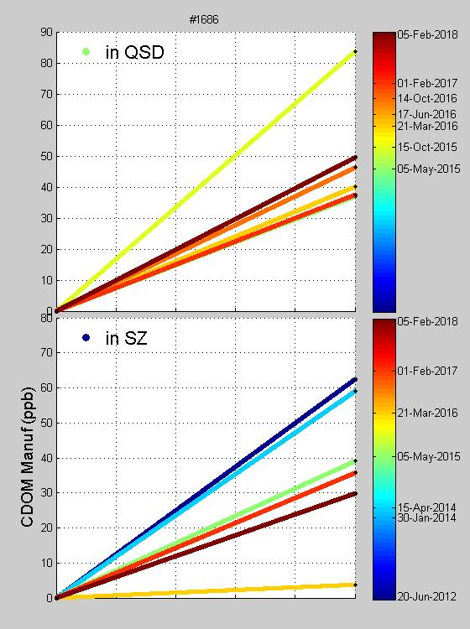
Standard Data and Scale Factors for FLCD#1686
SF = expected/(observed – DI)
offset = DI*SF
*average values
-5/5/15
-2/1/17
-2/5/18
Readings appear to be outliers in context of readings before and after or readings in other standard solutions

Slide 10
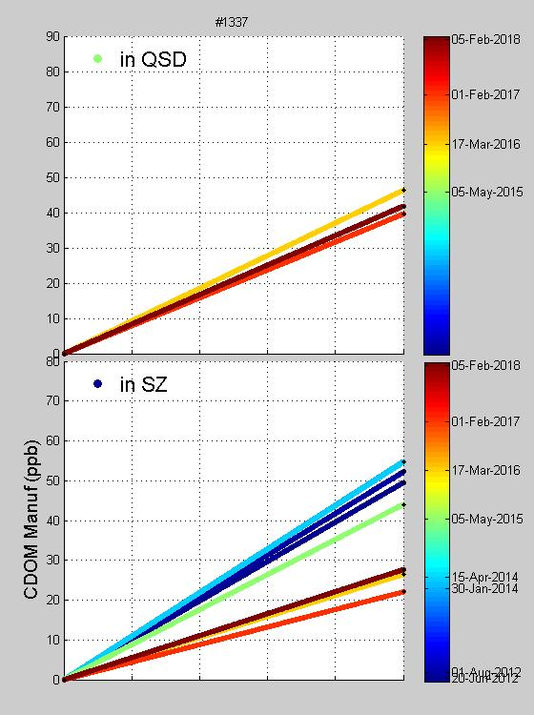
Standard Data and Scale Factors for WSCD#1337
SF = expected/(observed – DI)
offset = DI*SF
Notes:
Readings after the 2/17/16 calibration cluster in both standard solutions. The scale factor and offset calculated following this calibration have been applied for all data following re-calibration.

Slide 11
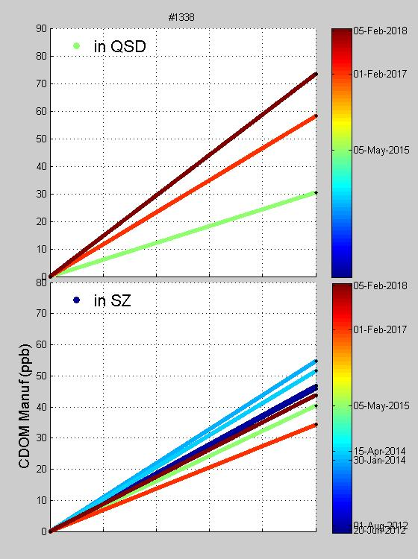
Standard Data and Scale Factors for FLCD#1338
SF = expected/(observed – DI)
offset = DI*SF

Slide 12
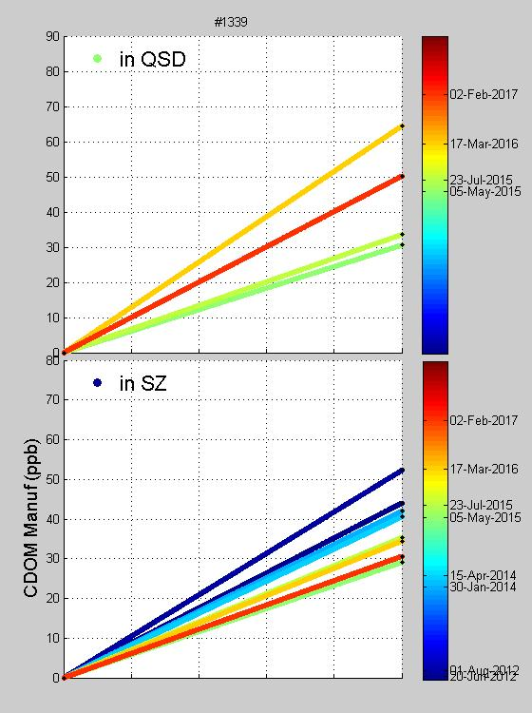
Standard Data and Scale Factors for FLCD#1339
Downward drift

Slide 13
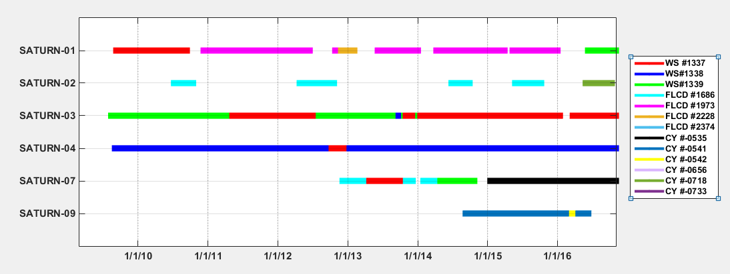
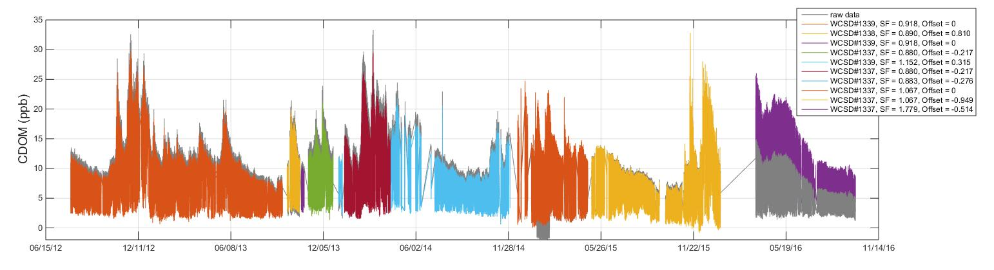
SATURN-03 CDOM Scaling (prior to 2018 revisions)
CDOM Sensors Deployed at SATURN-03
WSCD#1339
WSCD#1338
WSCD#1337
Gray: Raw Data
Colored Data: Different periods
of data scaling

Slide 14
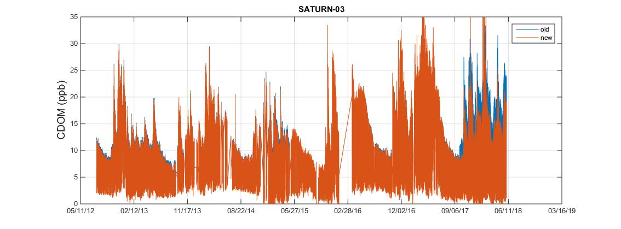
SATURN-03 results of 2018 scaling revisions

Slide 15
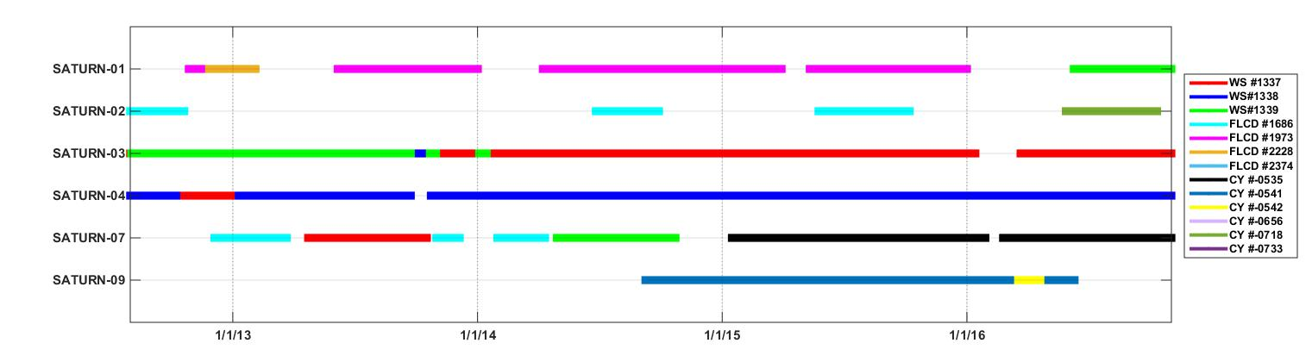
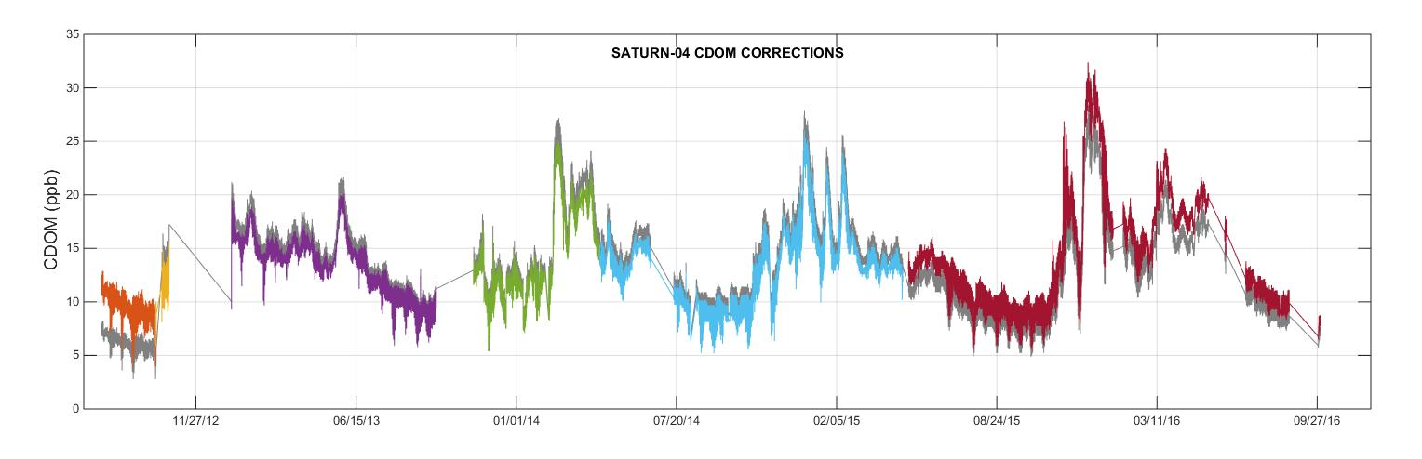
SATURN-04 CDOM Scaling (prior to 2018 revisions)
CDOM Sensors Deployed at SATURN-04
WSCD#1337
WSCD#1338
Gray: Raw Data
Colored Data: Different periods
of data scaling

Slide 16
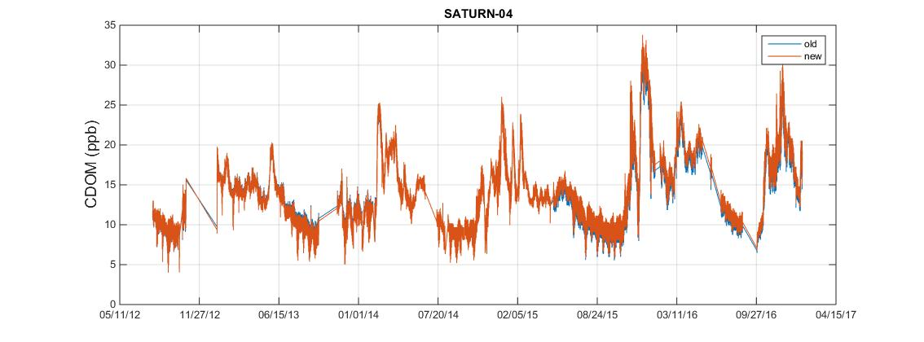
SATURN-04 results of 2018 scaling revisions

Slide 17
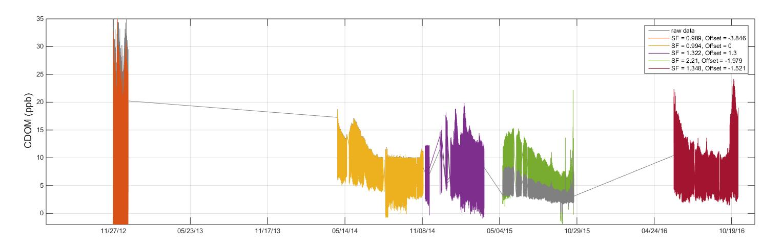
SATURN-01 CDOM Scaling (prior to 2018 revisions)
CDOM Sensors Deployed at SATURN-01
FLCD#2228
FLCD#1973
WSCD#1339
Gray: Raw Data
Colored Data: Different periods
of data scaling
Note:
Data from this deployment are flagged as bad;

Slide 18
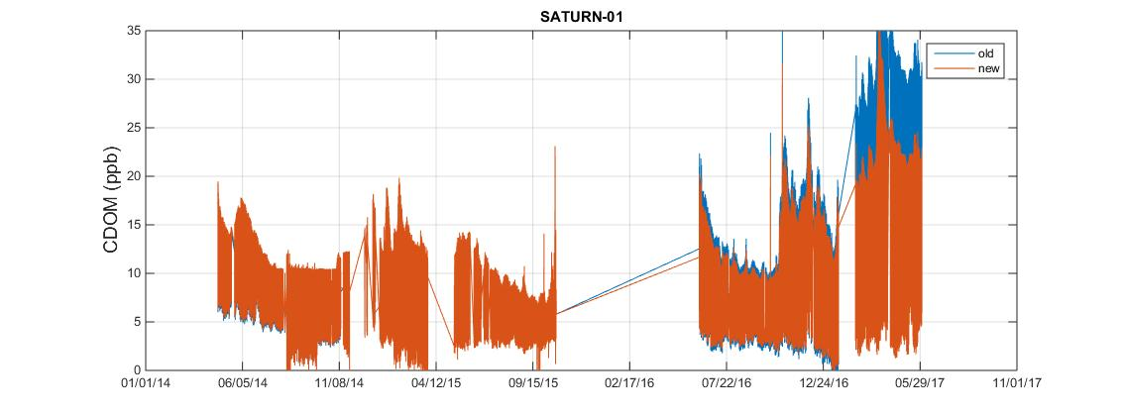
SATURN-01 results of 2018 scaling revisions

Slide 19
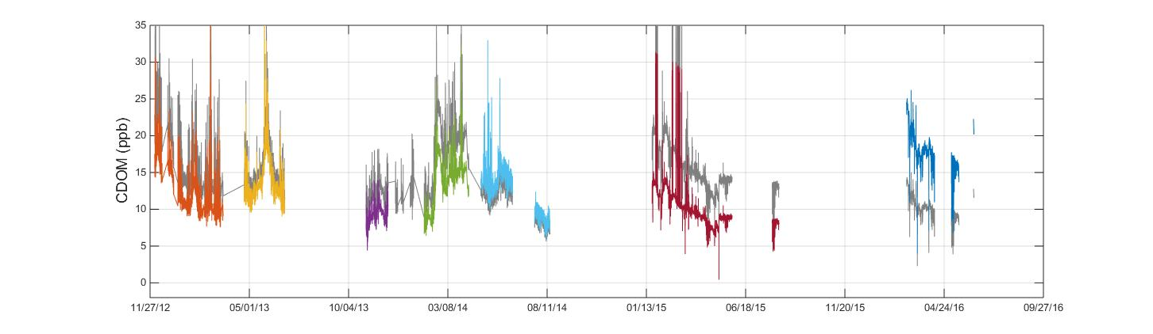
SATURN-07 CDOM Scaling (prior to 2018 revisions)
CDOM Sensors Deployed at SATURN-07
FLCD#1668
WSCD#1337
FLCD#1668
WSCD#1339
CY#0535
Gray: Raw Data
Colored Data: Different periods
of data scaling

Slide 20
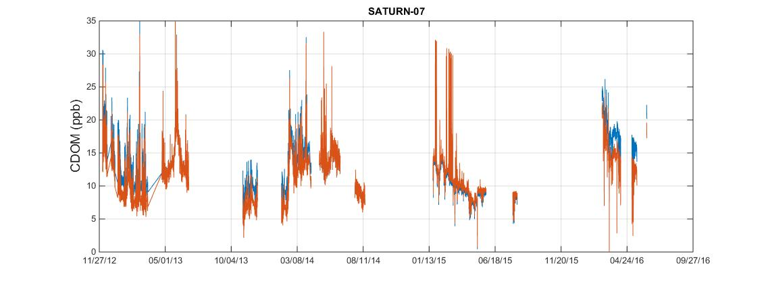
SATURN-07 results of 2018 scaling revisions

Slide 21
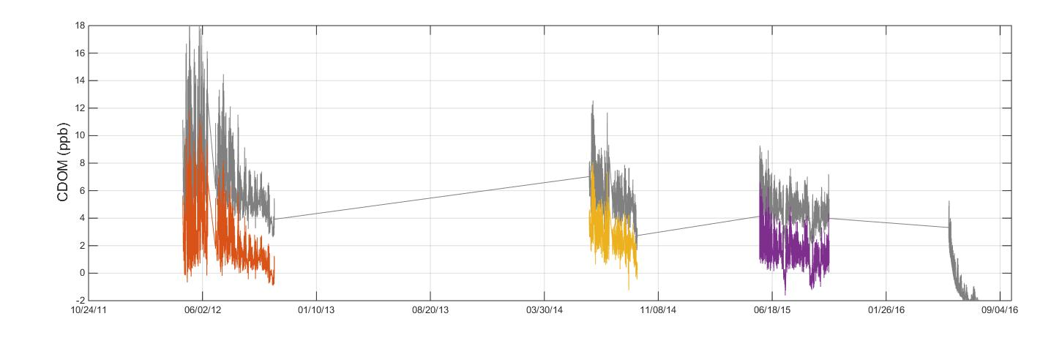
SATURN-02 CDOM Scaling (prior to 2018 revisions)
CDOM Sensors Deployed at SATURN-02
FLCD#1668
FLCD#1668
FLCD#1668
CY#0718
Gray: Raw Data
Colored Data: Different periods
of data scaling

Slide 22
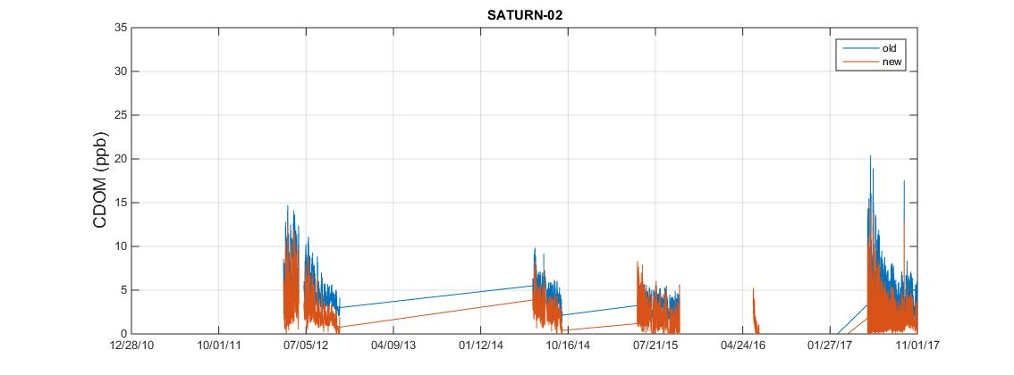
SATURN-02 results of 2018 scaling revisions

Slide 23
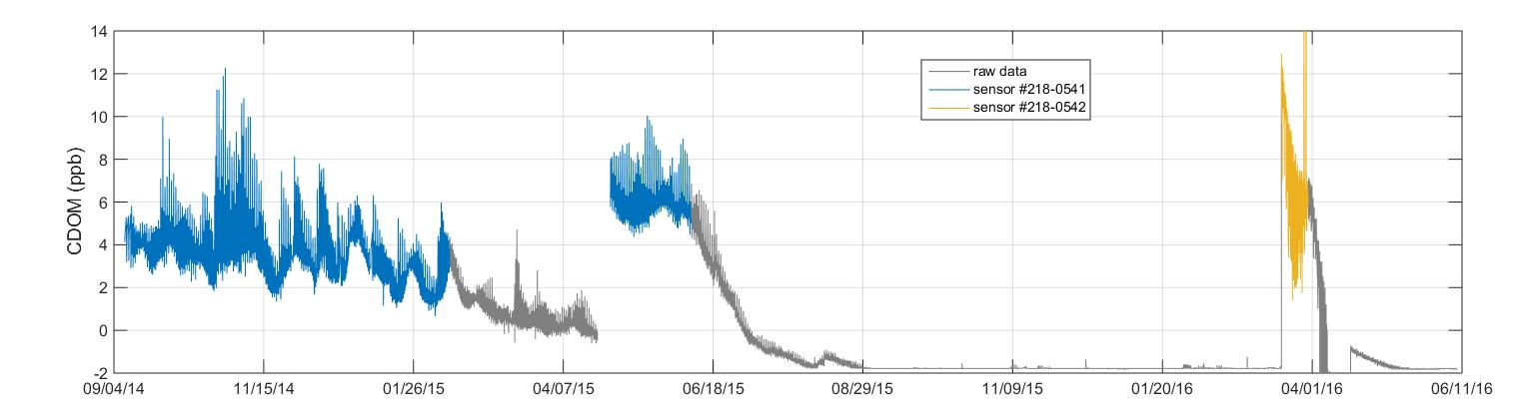
SATURN-09 CDOM
CDOM Sensors Deployed at SATURN-09
CY#0541
CY#0542
CY#0541
Gray: Raw Data
Colored Data: Different periods
of data scaling
The standard readings with the Turner Designs Cyclops 7 CDOM sensors have not yet yielded consistent results. Protocols to evaluate and scale sensor output for these sensors are still under development. In addition, the sensors have had multiple issues with performance while deployed as can be seen by the drop off in data for each deployment (gray data in figure above. The visibly bad data have been flagged as such while the remainder of data have been flagged as poor and should be used with caution. No scale factors have been applied to scale output from the SATURN-09 CDOM sensors to the output of other SATURN CDOM sensors.

Slide 24
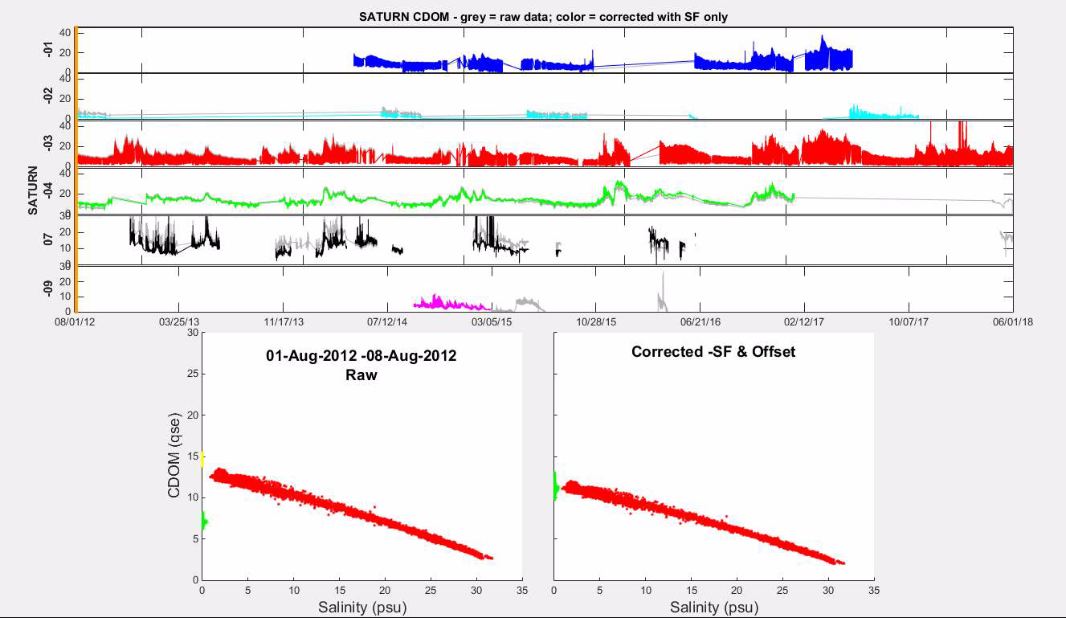
SATURN CDOM in relation to salinity (movie)
To Play:
Hover cursor over lower left corner and click the play icon to view the SATURN CDOM data in relation to salinity over time
Note:
After pausing the play, the cursor can be clicked anywhere in the play bar at the bottom to move the movie to that time-point

